Slide 1
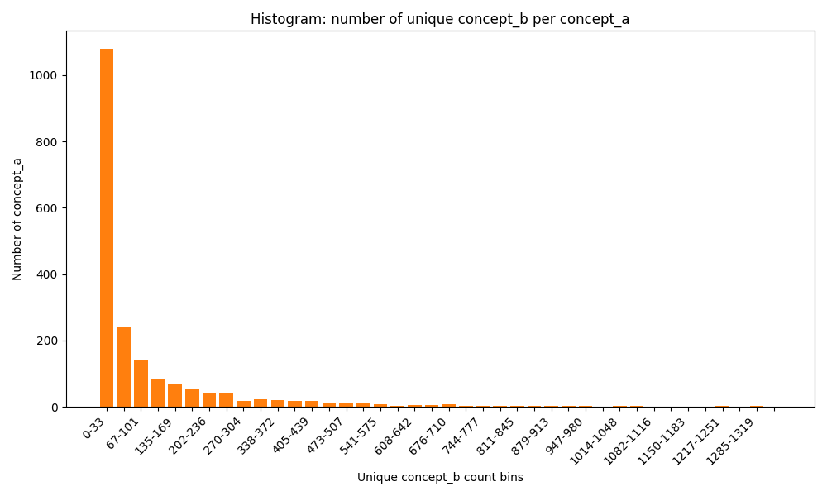
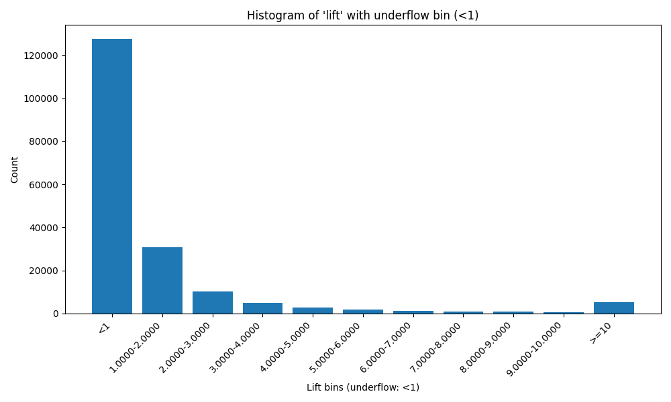
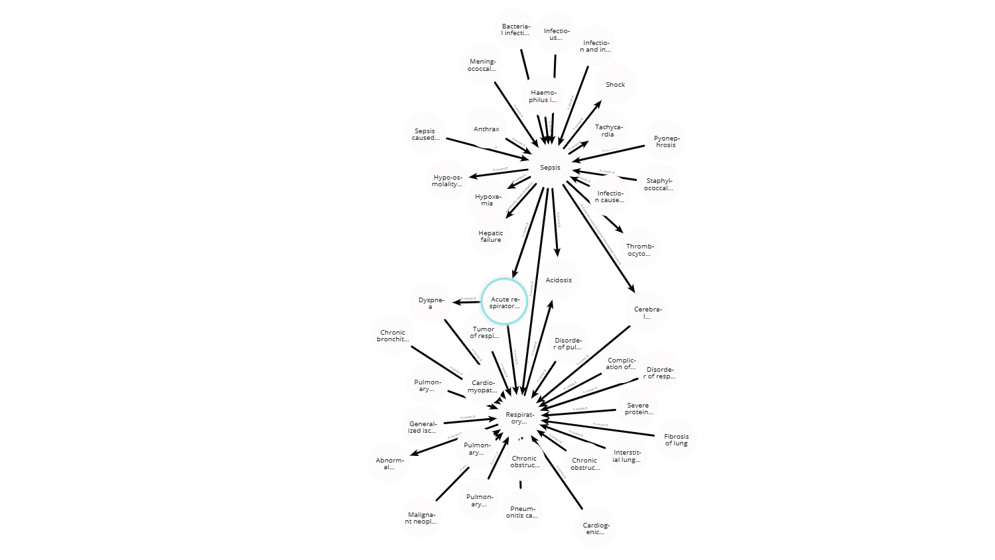
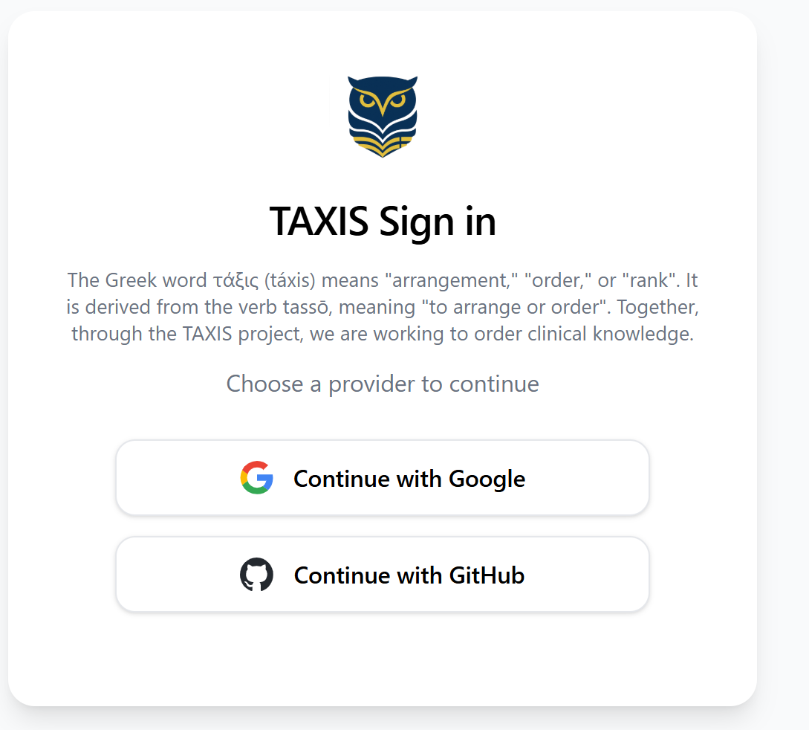





TAXIS
Step 1: Simplified Diagnostic Hierarchies and Relationship Tables for the OHDSI Community
:
Concept Pairs
A clinical knowledge graph with 1,948 coded concepts and 14,645 relationships with broad clinical coverage, generated through association-rule mining and LLM-validated links, demonstrates that scalable, cost-effective curation of meaningful diagnosis-diagnosis relations is feasible. These clinically credible connections pave the way for more robust cohort analyses, streamlined quality measures, and smarter decision-support rules without requiring labor-intensive manual curation.
PRESENTER: Steve Bandeian, MD, JD
INTRODUCTION
Clinical knowledge engineers and data analysts spend large amounts of time curating value sets and determining which features might be relevant. A credible dataset of typed relationships between clinical concepts would dramatically reduce that burden and allow large-scale analyses.
METHODS
A diagnosis hierarchy was developed that clustered clinically similar concepts to define diagnosis-based condition episodes.
A study package was created to query the OMOP CDM to find statistical relationships between pairs of concepts.
The study package was run against a subset of the INPC OMOP CDM consisting of 1,546,449 individuals who had a COVID test in 2018 forward.
An LLM (gpt 4-1, with temperature 0) was used to assign relationship types and direction for pairs with a potentially significant statistical lift.
The pairwise relationships were used to construct a directed graph with OMOP Concepts as the nodes.
RESULTS
Discovered 191,561 unique pairs with at least 50 occurrences. There were 1960 unique concept A terms, 2070 unique concept B terms. (Concepts appear only as A or B and never both).
CDM subset consisting of 1,546,449 individuals who had a COVID test in 2018 forward. The mean lift was 2.3 ± 30.8 with an interquartile range of 0.3 to 1.3.
39,437 pairs were assigned relationships
Statistical Lift
Relationship Types
Take a picture to go the TAXIS study page
Steve Bandeian, MD, JD,
J. Marc Overhage, MD, PhD,
Shaun Grannis, MS, MD
A fragment of the clinical knowledge graph

